Slide 1

Power BI
Azure Synapse DMV’s Analysis
Created: 13/08/2022

Slide 2





Big Data Projects
Use Case: Scenarios
Table Distribution Analysis
Get rich quality metadata understanding on Column Store Segments
Understand RowGroupState based on all table names
Workload Management
Understand WorkGroupState in order to understand heavy workloads
Azure Synapse DMVs
Query Executions
Understand “Total Elapsed Time” from “RequestSteps table
Storage Optimization
Get rich quality metadata ColumnStoreRowGroups
Shrikesh Pattni

Slide 3
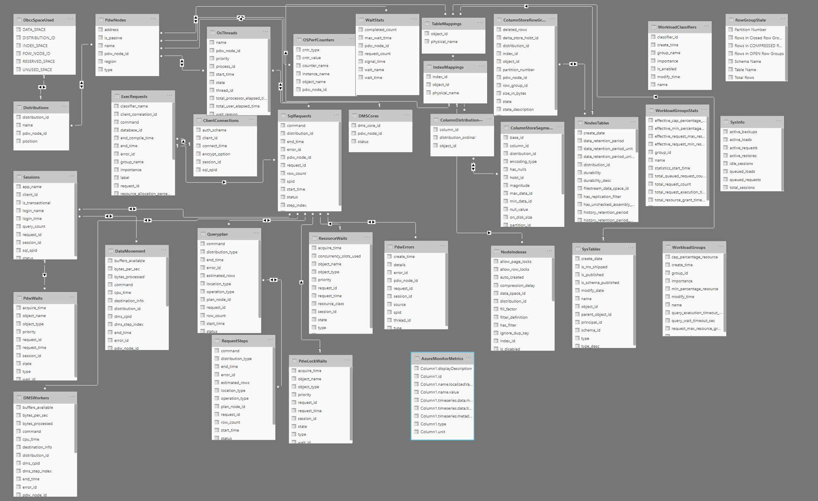
Shrikesh Pattni

